Slide 1

PLATEAU MEDICLAIM INSURANCE REPORT ANALYSIS
PAUL S. UMARU
#cODeplateau 4.0
Notes:
September 2022

Slide 2
STATEMENT OF PROBLEM
Leveraging customer information is of paramount importance for most businesses. In the case of Mediclaim insurance company, the attributes of customers can be crucial in making business decisions.
This report analysis focuses on the detailed information of Mediclaim customer base, behaviors and relationships. Also providing observatory solutions.

Slide 3
OBJECTIVES
Exploring the dataset and extracting insights
Prove(or disprove) that the medical claims made by the people who smoke are greater than those who don't?
Prove (or disprove) that the BMI of females is different from that of males.
Does the smoking habit of customers depend on their region?
Knowing If the mean BMI of women with no children, one child, and two children the same.

Slide 4
INSURANCE DATA RECORD
 | age | sex | bmi | children | smoker | region | charges
0 | 21 | female | 16.000 | 1 | no | northeast | 3167.45585
1 | 18 | male | 33.770 | 1 | no | southeast | 1725.55230
2 | 28 | male | 33.000 | 3 | no | southeast | 4449.46200
3 | 33 | male | 22.705 | 0 | no | northwest | 21984.47061
4 | 32 | male | 28.880 | 0 | no | northwest | 3866.85520
Notes:
The record is mad up of 1338 rows and 7 columns. Above is the top 5 records.

Slide 5
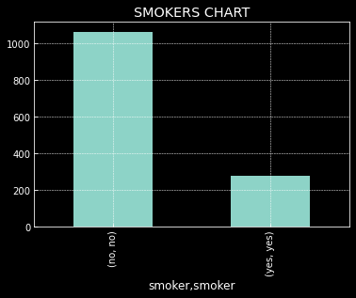
Smokers Chart to Prove(or disprove) that the medical claims made by the people who smoke are greater than those who don't?
Notes:
Graphical description above shows that no smokers are greater than smokers indicating that majority of the customers are non smokers.

Slide 6
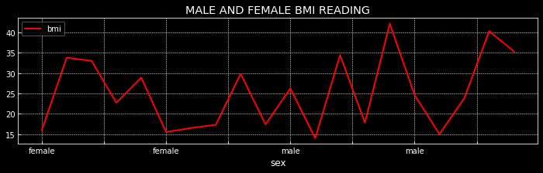
Visualization from the Dataset showing that the BMI of females is different from that of males.
Notes:
The highest bmi reading of females is 34 whilst the male bmi highest reading is about 50 and the least bmi reading are 16 and 15 respectively. Indicating that the Male and Female BMI reading varies meaning aren't the same .

Slide 7
Smoking Habits By Region
smoker | no | yes
region
northeast | 257 | 67
northwest | 267 | 58
southeast | 273 | 91
southwest | 267 | 58
Notes:
Table showing total number of the smoking habits of customers in different region covered by Mediclaim Insurance.

Slide 8
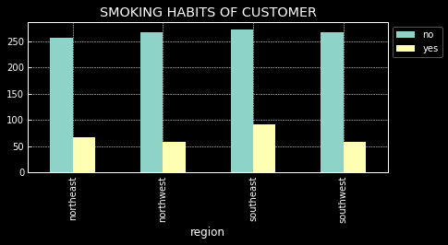
Visualization to show if the smoking habit of customers depends on their region.
Notes:
The above visualization shows that smoking habit depends on region considering the no_ smokers of each region is relative to the smokers. Southeast has the highest number of smokers(91) and non smokers(273). Whilst Northeast has the lowest non smokers(257) and smokers(67). In all, the number of non smokers is higher than the numbers of smokers signifying a healthy community/State.

Slide 9
Table Showing the mean BMI of women with no children, one child, and two children the same.
 | SEX | BMI | CHILDREN
0 | female | 16.00 | 1
5 | female | 15.50 | 2
6 | female | 16.50 | 2
7 | female | 17.29 | 0
9 | female | 17.40 | 1
11 | female | 14.00 | 2
13 | female | 17.80 | 0
16 | female | 15.00 | 2
20 | female | 17.05 | 0
Notes:
It's observed from the above table that the mean bmi of women and their number of children aren't the same as it varies i.e., those with same 1 children, 2 children or 0 children have different bmi readings.

Slide 10
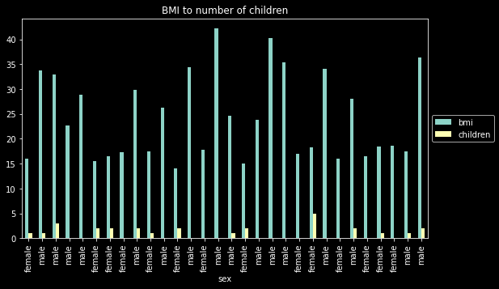
Chart showing sex and the BMI to number of children

Slide 11

OBSERVATIONS
The number of no smokers(1064) is more than the number of smokers(274) in Plateau.
The report covers age from 18-64yrs with majority of the age population between 18 and 36yrs amounting to about 60% of the insurance coverage.
Majority of charges incurred falls within 1000 to 5000 with the least charge at 1121. And a total Insurance charges of #17,755,824.99 in the period under review.

Slide 12
Observations Cont.
4. It's observed that those with 1 and 3 children are mostly no_smokers whereas those with 0 children take the lead as smokers identifying the effect smoking is causing the community in child reproduction.
5. It's also observed that those with 0 number of children and 2 numbers of children incure more Mediclaim charges than the others 3.Total number of children covered is 1465

Slide 13

CONCLUSION
In Conclusion, it’s observed from the multivariate analysis of all numerical values, that 0 number of children(meaning those without children) are heavily affected in insurance charges and age distributions features.

Slide 14


